Slide 1

CS244
Advanced Topics in Networking
Lecture 9: SDN (2)
Network Virtualization
Nick McKeown
“Network Virtualization in Multi-tenant Datacenters,”
[Teemu Koponen et al, 2014]
Spring 2020

Slide 2
Context
Teemu Koponen
Early employee Nicira
Sigcomm Rising Star Award, 2012
More recently, co-founder at Styra
Teemu

Slide 3
SDN: In the context of bigger networking industry changes

Slide 4
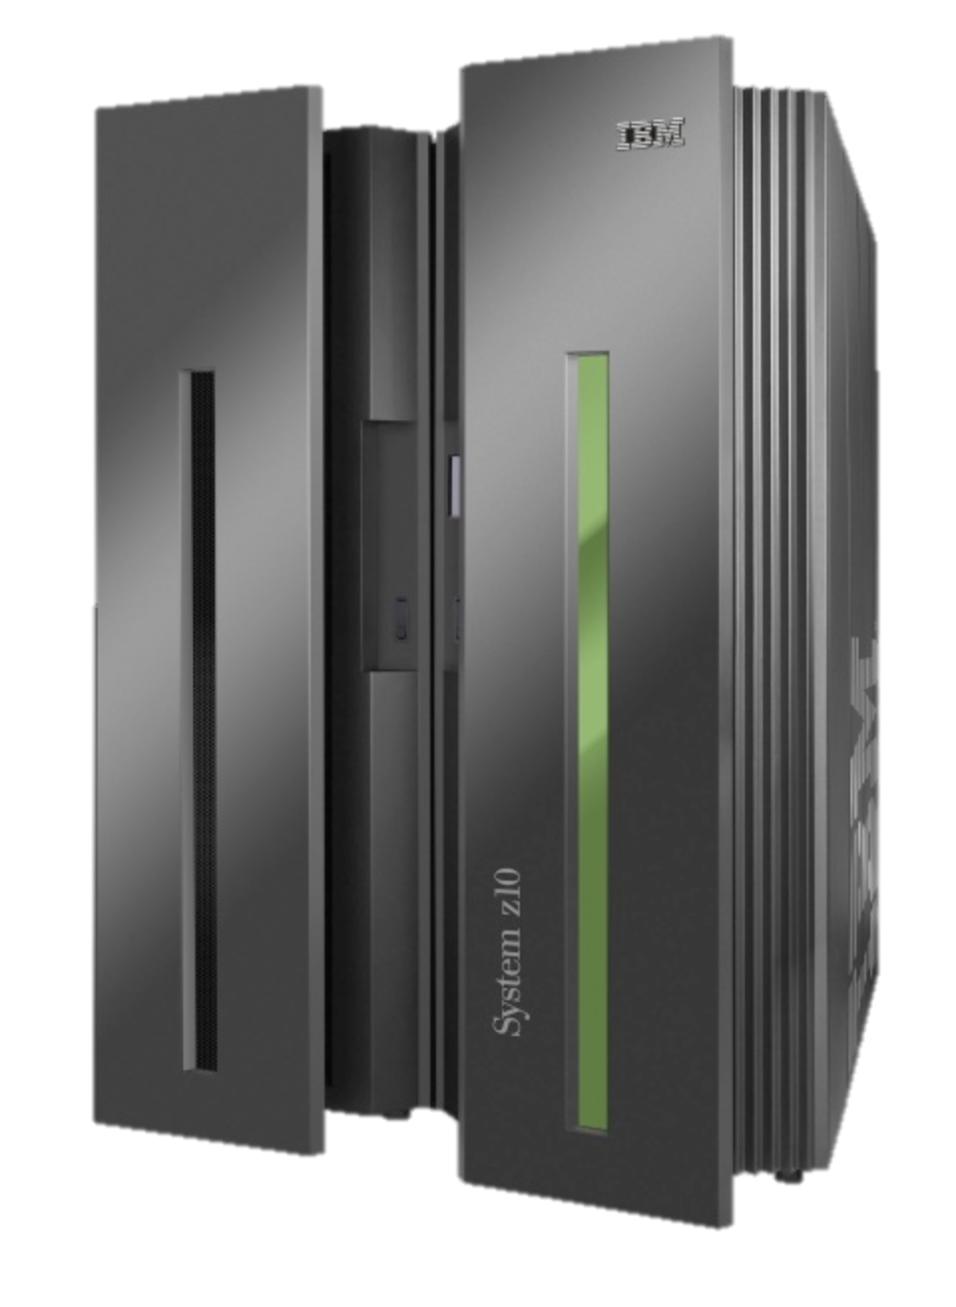
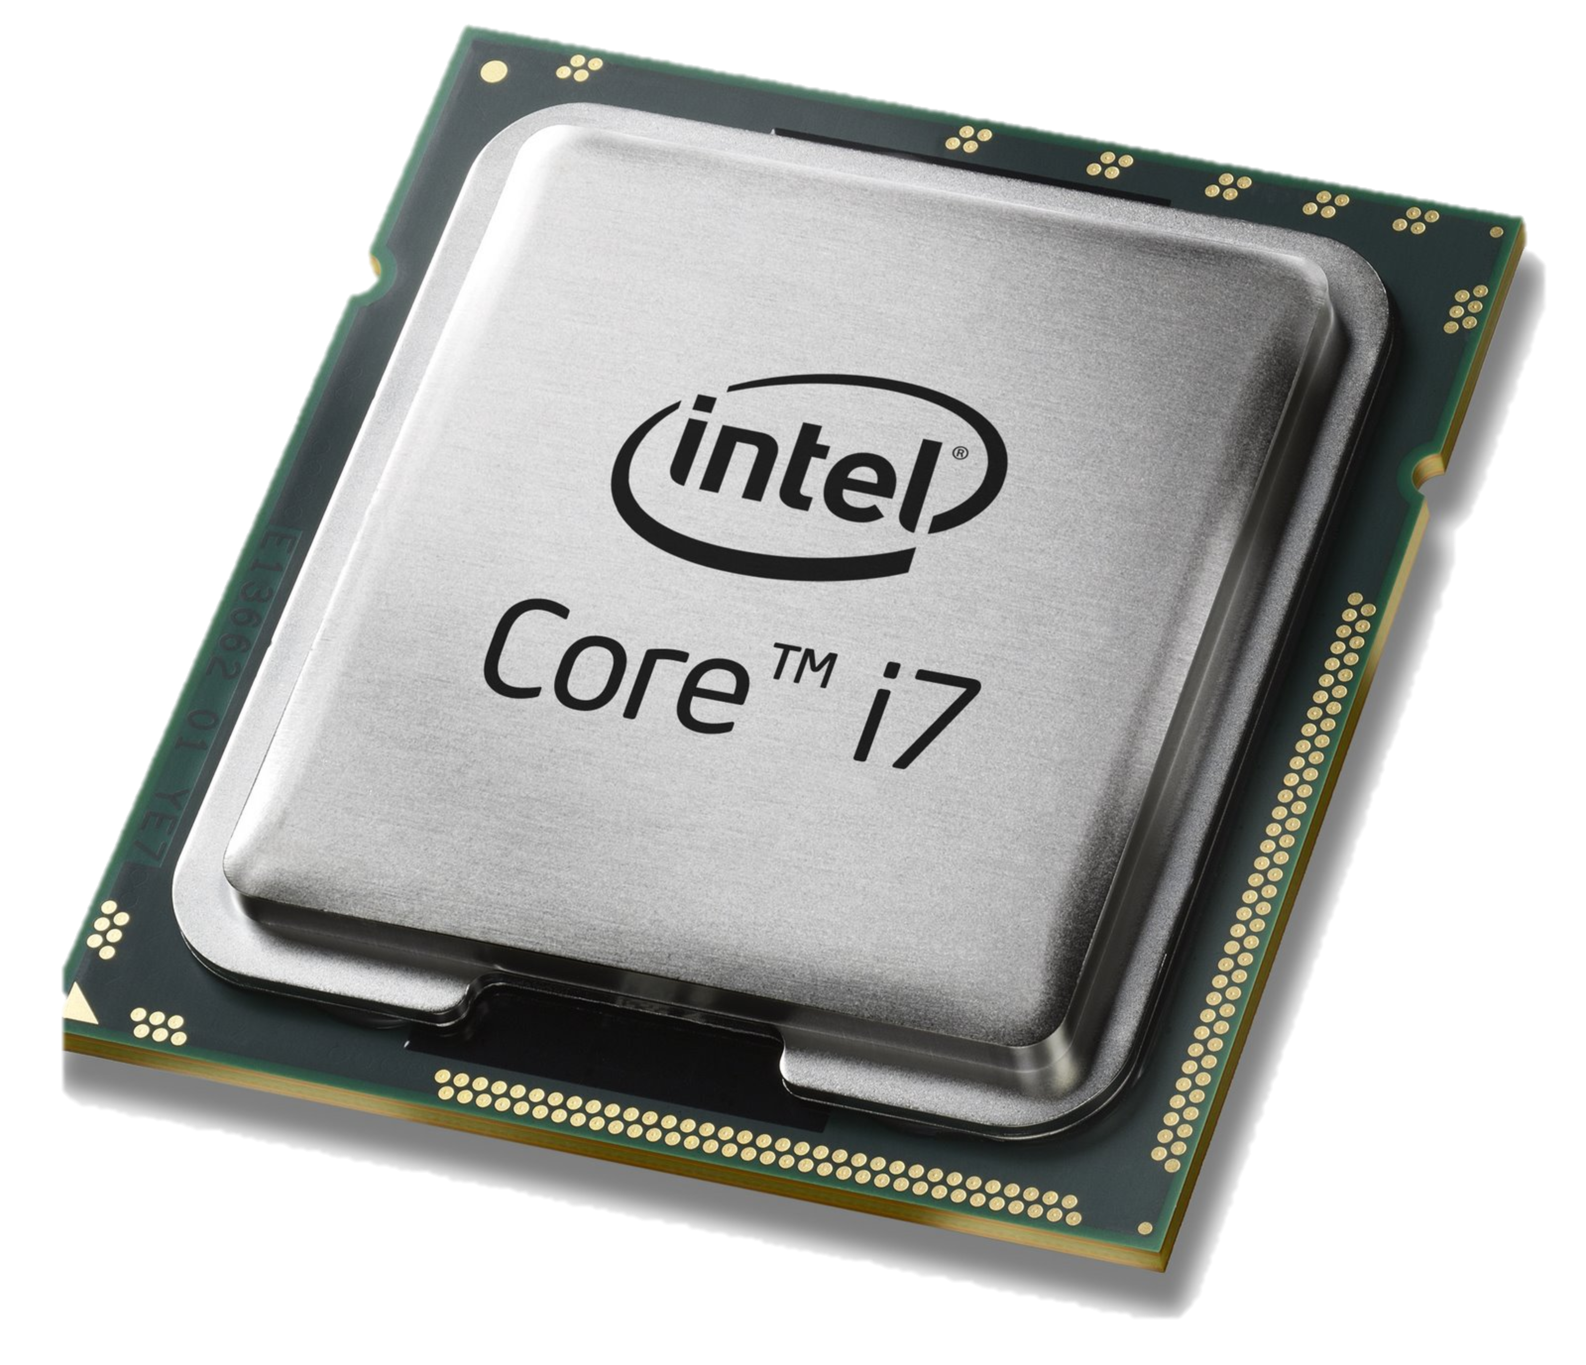
Computer Industry
App
App
App
App
App
App
App
App
App
App
App
Specialized
Applications
Open Interface
Specialized
Operating System
Windows
(OS)
Linux
Mac
OS
or
or
Open Interface
Specialized
Hardware
Microprocessor

Slide 5
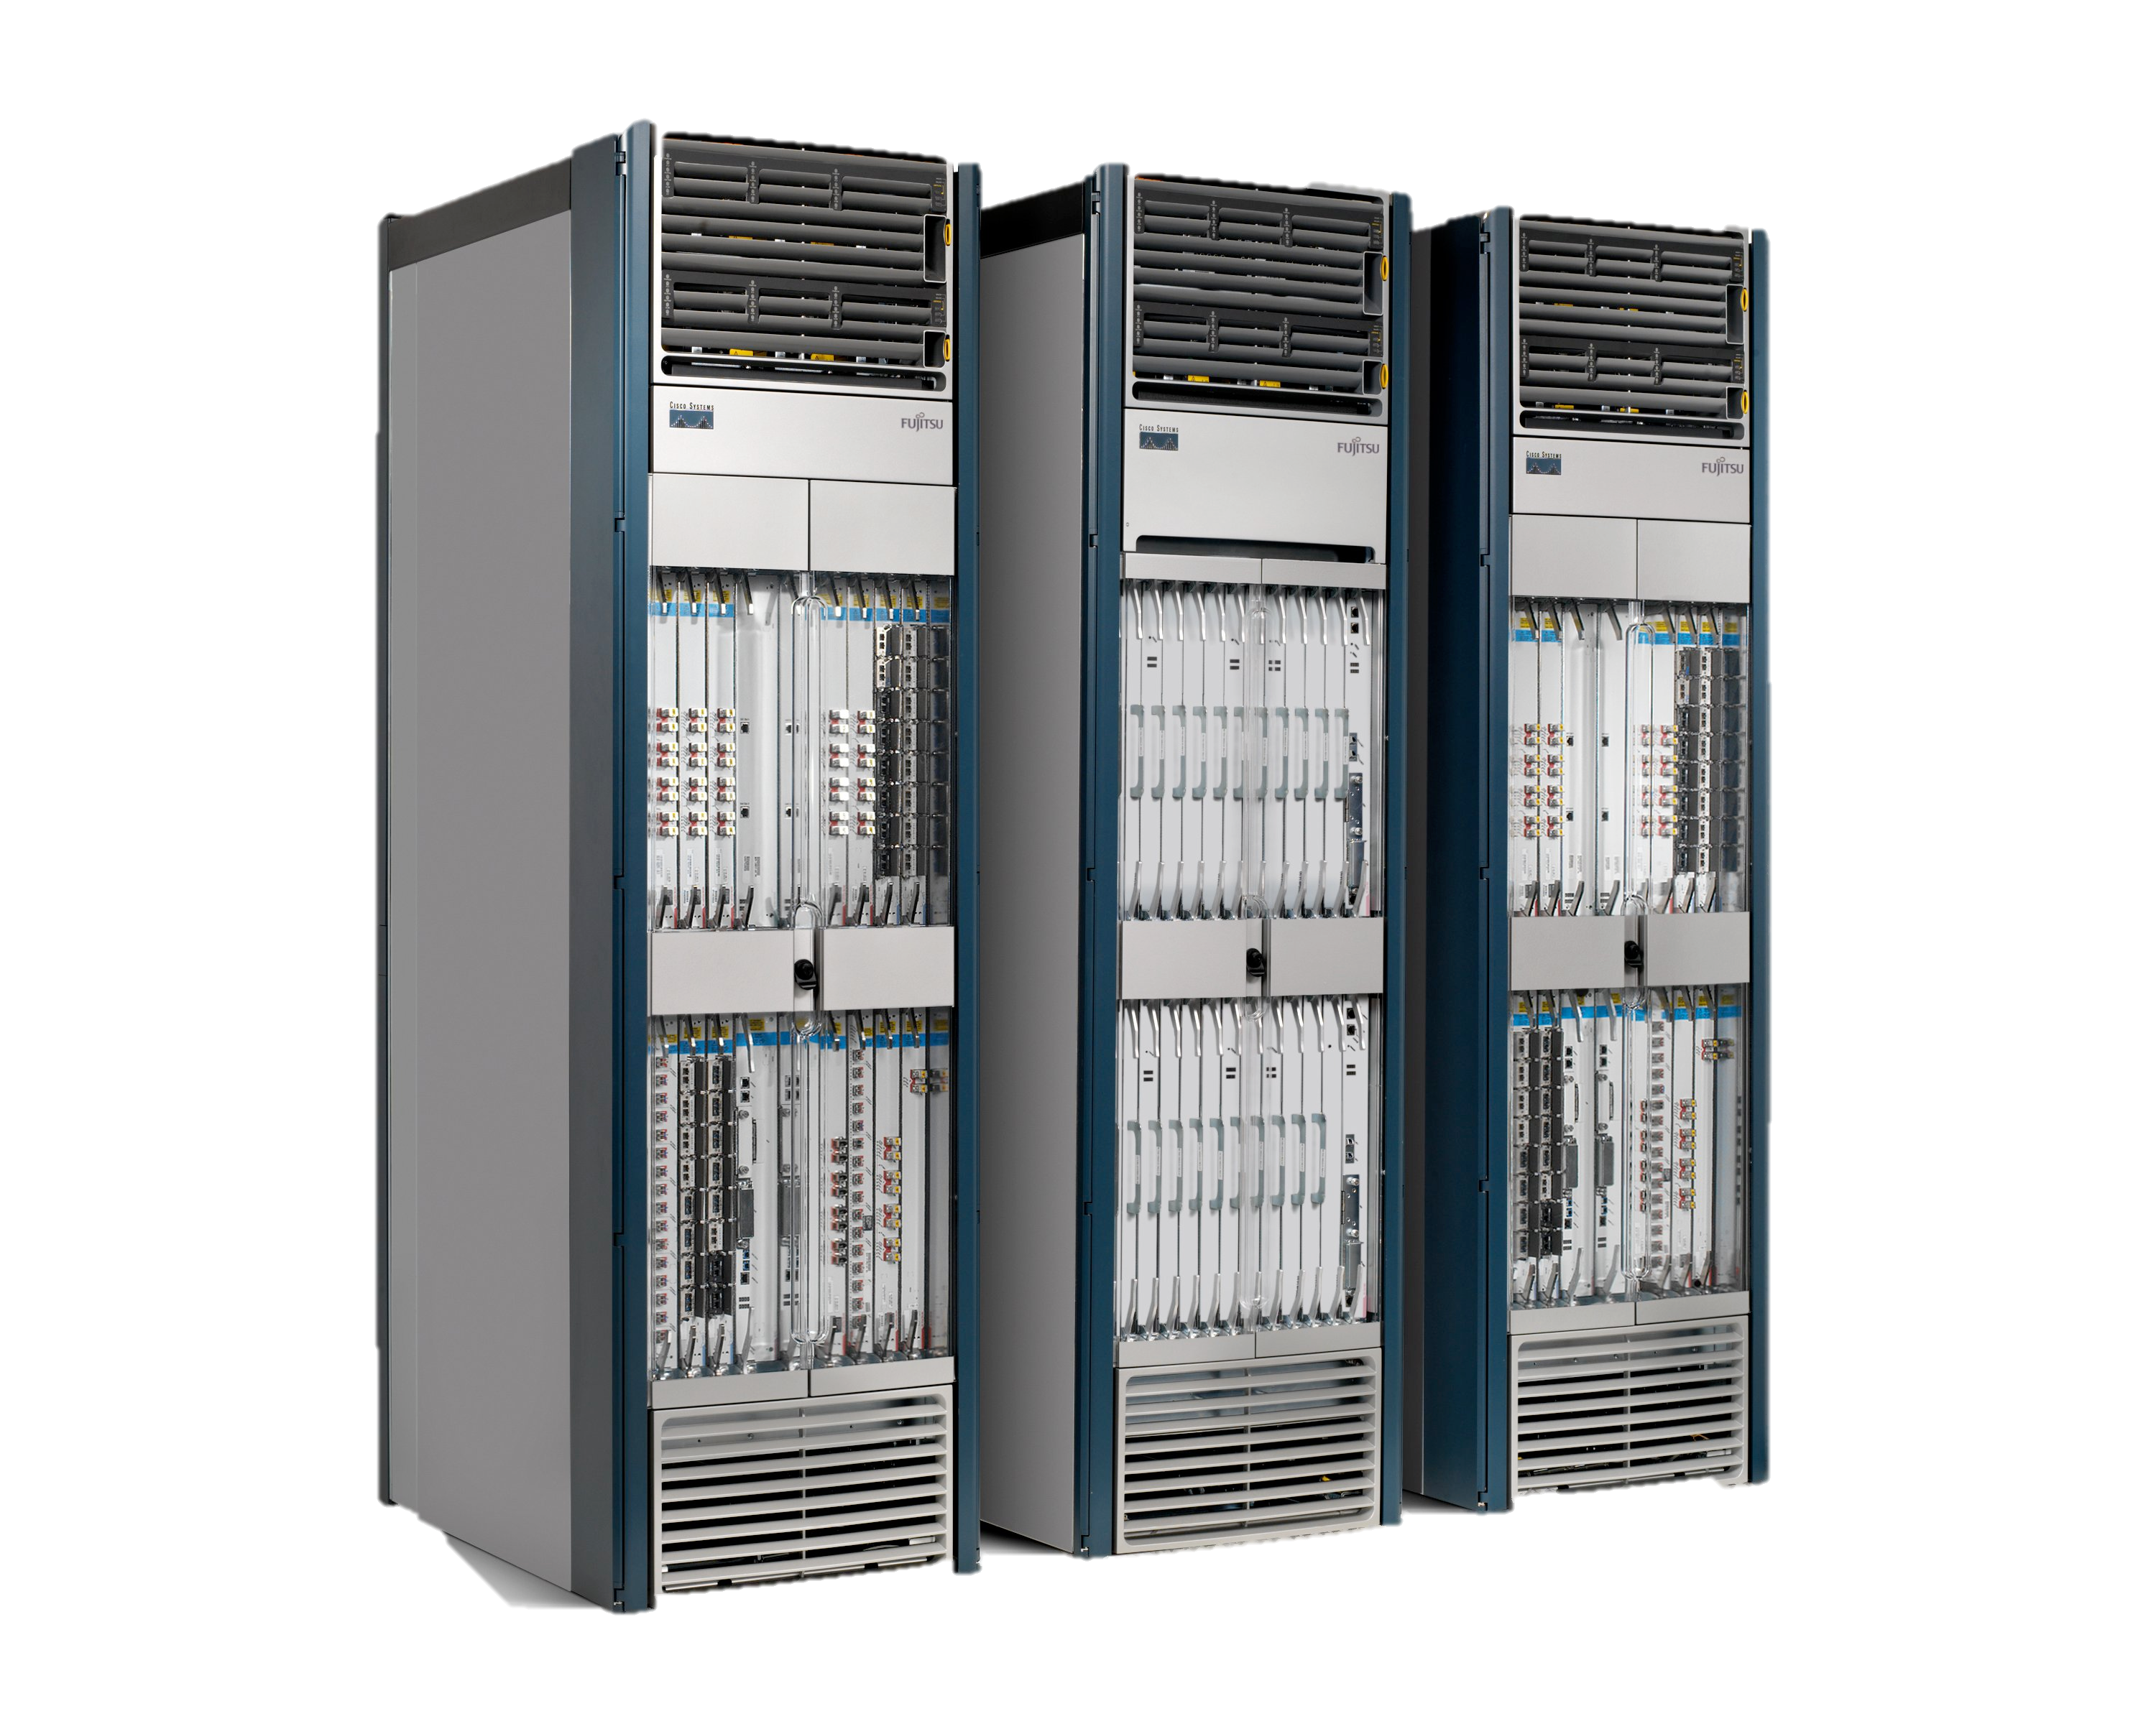
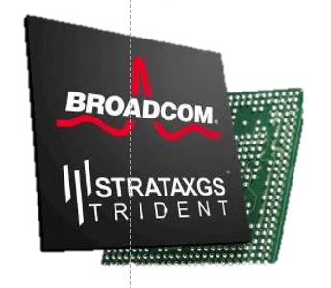
Networking Industry
App
App
App
App
App
App
App
App
App
App
App
Specialized
Features
Open Interface
NOX
Beacon
ONIX
POX
ONOS
Flood light
Trema
ODL
Ryu
Control Plane 1
Control Plane 2
Specialized
Operating System
Open Interface
Switch Chips
Specialized
Hardware
“Software is eating the world (of networking)”

Slide 6
Network Function Virtualization (NFV)
Public Internet
Middlebox
Firewalls
Load-balancing
NAT
Boundary routers
Deep Packet Inspection
DDoS Mitigation
Middlebox
Middlebox
Middlebox
Packet
Forwarding
Packet
Forwarding
Packet
Forwarding
Packet
Forwarding
Packet
Forwarding

Slide 7
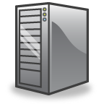
Network Function Virtualization (NFV)
Public Internet
VM
VM
VM
Middlebox
Packet
Forwarding
VM
VM
VM
Firewalls
Load-balancing
NAT
Boundary routers
Deep Packet Inspection
DDoS Mitigation
Packet
Forwarding
Packet
Forwarding
Packet
Forwarding
Packet
Forwarding
Packet
Forwarding

Slide 8
With hindsight, Disaggregation, SDN and NFV were probably inevitable
Part of a bigger trend towards the owners and operators of networks taking control of how they manage their networks

Slide 9
Inevitable because…
Rise of Linux.
Rise of baremetal servers and data centers.
SDN: Rise of merchant switching silicon.
NFV: Rise of computer virtualization.

Slide 10
Today

Slide 11
Most networking equipment is disaggregating
Intra- and inter-datacenter networks
ISP routers and switches
WiFi APs
Cellular basestations (4G, 5G…)
Optical and Metro Transport
Residential broadband access
Enterprise network equipment: switch, router, firewall

Slide 12
Network Virtualization

Slide 13
“Modularity based on abstraction is the way things are done!”
Barbara Liskov (MIT) Turing Award Lecture 2009
Notes:
As Barbara Liskov said about computer science: “Modularity based on abstraction is the way things are done!” Abstractions are arguably the foundation upon which computers and entire data-centers are built.
I actually think the past ten years in networking has been all about creating new abstractions for network control planes.

Slide 14
Abstractions in computer systems
Virtual memory: Abstract illusion of infinite, private physical memory
File system: Uniform illusion of read/write data store.
Virtual Machine: User application cannot tell if it is running on a physical or virtual machine.
…
Notes:
The world of computing is built on a foundation of clever abstractions.
The abstraction of virtual memory means our applications don’t have to worry about managing physical memory locations and caches. Abstractions for file systems means our applications can open, update and close files without needing to know what hardware the file system uses, or where it is located. The abstraction of an operating system means our applications don’t have to worry about how processes are scheduled and peripherals are shared.

Slide 15
What is “network virtualization”?
In this context: The abstraction (or illusion) of a physical network in which the user, application (and possibly the administrator too) cannot tell if the network is physical or virtual.
Q: If true, what would be the benefits?

Slide 16
Will Robert Brand:
…does this kind of virtualization have any advantages in aggregate? That is, under NVP, are there positive or negative externalities to running diverse logical topologies in the same datacenter?
Notes:
Advantages:
DC owner can move VMs around without changing addresses. Why would that matter?
Can connect back to home network using same addresses
Can potentially allow each tenant to have its own network features. One might want IPv4, another IPv6, another might want firewalls, load-balancing; yet another might use flat Ethernet.
Can connect back to same home network using same features and middleboxes.
Can potentially move to new data center or cloud, if they are compatible.

Slide 17

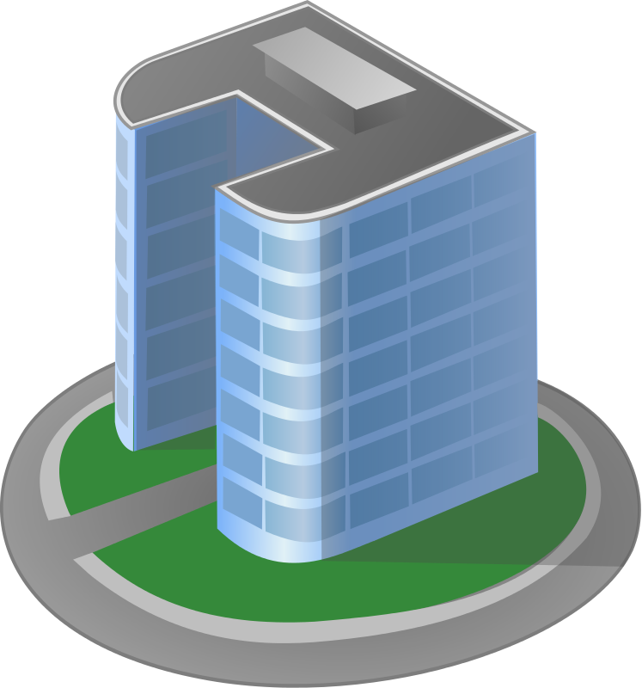
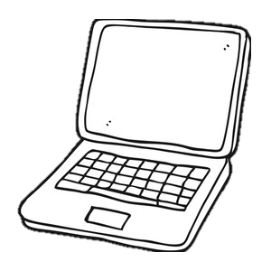
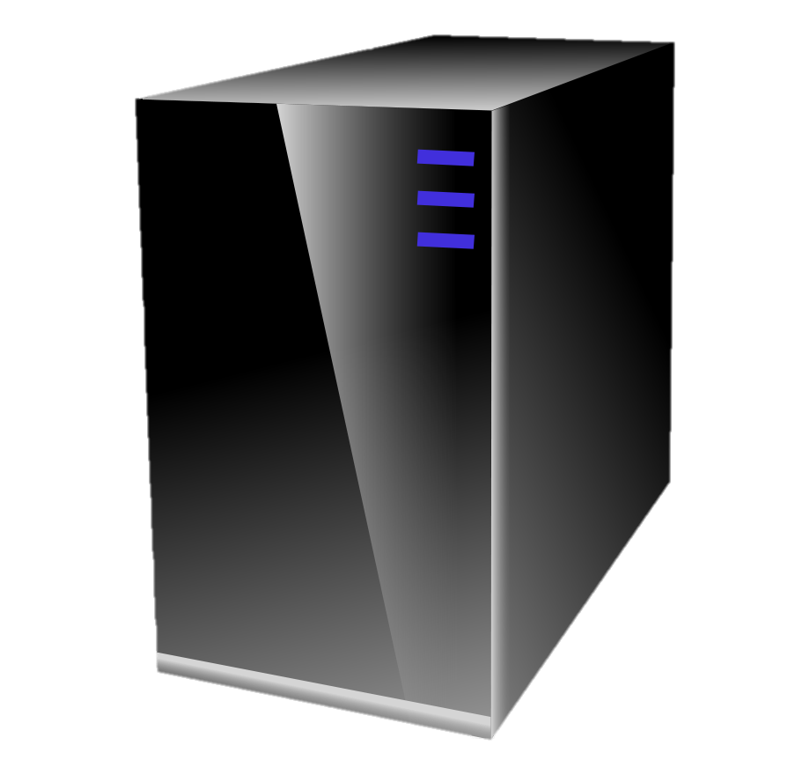
Early attempts at network virtualization
Example: VPN
Web browser
IP Datagram
IP datagram
IP Datagram
Tunnel
Hdr
VPN Client
VPN Server
Public Internet
Corporate HQ
Q: To what extent is this virtualization?
Notes:
Not a clean abstraction: Just abstracts forwarding, not control.

Slide 18
Early attempts at network virtualization
Example: Slicing
Each controller can read and/or write flow rules for its assigned portion of “header space” and topology
Control
Program
Control
Program
CP 1a
CP 1b
CP 2a
CP 2b
CP 3a
CP 3b
CP 4a
CP 4b
Control Plane 1 (“Network OS”)
Control Plane 2 (“Network OS”)
Control Plane 3 (“Network OS”)
Control Plane 4 (“Network OS”)
OpenFlow
OpenFlow
OpenFlow
OpenFlow
Network Slicer (e.g. FlowVisor)
Q: To what extent is this virtualization?
Packet
Forwarding
Packet
Forwarding
OpenFlow
Packet
Forwarding
Packet
Forwarding
Packet
Forwarding
Notes:
Slices up the header space resources; can’t support arbitrary address space.

Slide 19
Trends at the time of writing
Data centers and clouds F efficiency matters
VMs F a vSwitch inside every server
SDN F abstraction for control

Slide 20
Virtual vSwitch in every server
Control Plane
(“Network OS”)
OpenFlow
VM
VM
VM
Packet
Forwarding
NIC
vSwitch
OS
Q: How might the vSwitch help?
Notes:
Provides a software control point inside every server.
Background: OVS (Open vSwitch) was created at the time, to go with NVP, and upstreamed to Linux distributed.

Slide 21
SDN and Network Virtualization
Control
Programs
Control
Programs
Control
Programs
Abstract Network View
Network Virtualization
Global Network Map
Control Plane (“Network OS”)
Packet
Forwarding
Packet
Forwarding
Packet
Forwarding
Packet
Forwarding
Packet
Forwarding
Notes:
Note virtualization goes above control plane in this case: Each control program sees an abstract model of the network to control.

Slide 22
Another way to create a VPN
Control Plane
(“Network OS”)
OpenFlow
OpenFlow
VM
VM
VM
IP datagram
VM
VM
VM
IP Datagram
Tunnel
Hdr
Packet
Forwarding
NIC
NIC
NIC
Packet
Forwarding
vSwitch
vSwitch
OS
OS
Public Internet
“If destination is remote,
encapsulate in IPsec”
Observation 1: Control Plane tells vSwitch how to process packets into/out of tunnel

Slide 23
In a virtualized cloud service provider
192.5.0.0/24
192.5.1.0/24
VM
VM
VM
Control Plane
VM
VM
VM
128.30.2.200
171.64.74.155
128.30.2.109
171.64.74.157
OpenFlow
192.5.1.1
192.5.0.1
Packet
Forwarding
OpenFlow
Packet
Forwarding
vSwitch
vSwitch
A mesh of tunnels between all physical servers.
vSwitch translates addresses into and out of tunnels.
Observation: Tenant workloads (VMs) are isolated from each other.
Observation: VMs can move without changing address.
VM
VM
VM
VM
VM
VM
128.30.2.110
171.64.74.156
171.64.74.158
192.5.0.2
Packet
Forwarding
Packet
Forwarding
192.5.1.2
vSwitch
vSwitch

Slide 24
PHY-0/24
PHY-1/24
VM
VM
VM
VM
VM
VM
V-0.200
V-1.155
V-0.109
V-1.157
PHY-0.1
Packet
Forwarding
Packet
Forwarding
PHY-1.1
vSwitch
vSwitch
IP datagram
IP Data
V-0.110
V-0.109
PHY-0.2
PHY-1.1
VM
VM
VM
VM
VM
VM
V-0.110
V-1.156
V-1.158
PHY-0.2
Packet
Forwarding
Packet
Forwarding
PHY-1.2
vSwitch
vSwitch

Slide 25
VM
171.64.74.160
“VIP-DIP Gateway”
PHY-0/24
IP datagram
PHY-1/24
VM
VM
VM
IP Data
V-1.155
V-1.160
PHY-0.1
PHY-GW
VM
VM
VM
171.64.74.155
171.74.74.157
PHY-0.1
Packet
Forwarding
Packet
Forwarding
PHY-1.1
vSwitch
vSwitch
VM
VM
VM
VM
VM
VM
171.64.74.156
171.64.74.158
PHY-0.2
Packet
Forwarding
Packet
Forwarding
PHY-1.2
vSwitch
vSwitch

Slide 26
Adding a distributed, virtual firewall
IPv4 Table
Actions
Actions
Actions
Actions
IPv6 Table
ACL Table
PHY-0/24
L2 Table
PHY-1/24
VM
VM
VM
VM
VM
VM
V-0.200
V-1.155
Firewall
V-0.109
V-1.157
PHY-0.1
Packet
Forwarding
Packet
Forwarding
PHY-1.1
vSwitch
IP Data
V-0.200
V-0.109
PHY-0.1
PHY-1.1
vSwitch
VM
VM
VM
VM
VM
VM
V-0.110
V-1.156
V-1.158
PHY-0.2
Packet
Forwarding
Packet
Forwarding
PHY-1.2
vSwitch
vSwitch

Slide 27
In general
Control Plane
OpenFlow
OF0
OF1
OFn
VM
VM
VM
VM
VM
VM
Packet
Forwarding
Packet
Forwarding
vSwitch
Virtual middleboxes
vSwitch
It is generically called: “Overlay network virtualization”
Q: To what extent is this “network virtualization” ?
VM
VM
VM
VM
VM
VM
Packet
Forwarding
Packet
Forwarding
vSwitch
vSwitch

Slide 28
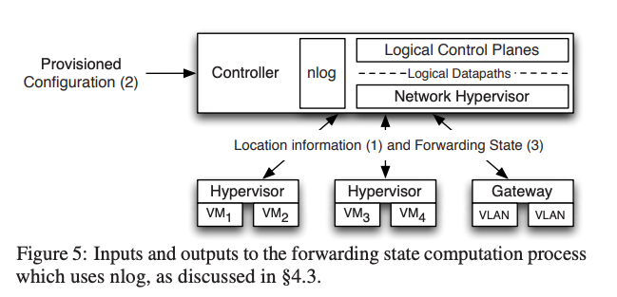
NVP is proactive: Pushes rules and state top-down
3: Calculates forwarding pipeline model for each vSwitch and the state for each table. Pushes via OpenFlow and OVS control protocol.
2: Datacenter owner configures
the networks: topologies and protocols.
1: Provide location,
state and topology.
Even as VMs move.
OVS control protocol.

Slide 29
Top-down proactive control
Goals:
Scale: Controller does not process packets
Isolation: To continue if VMs, vSwitches fail F controller is a distributed, resilient cluster
Immense computational challenge!
NVP is built on ONIX, a distributed SDN controller (used by Google)
Each NVP/ONIX controller manages some slices (shards); and is responsible for others, if a controller fails.
NVP uses Apache Zookeeper for
Leader election: to coordinate global resources and load-balancing) and
Label allocation: Logical egress port must be globally unique

Slide 30
Scaling Challenges
Margalit Ruth Glasgow:
Technical question: The authors mention in the "Lessons Learned" that using OpenFlow requires O(n^2) operations to tailor flows for each hypervisor, vs the standard complexity of O(n) for the logical controller. Where do those numbers come from? Does the O(n) come from each VM having O(1) connections at once, and the O(n^2) from each hypervisor needing to always have a connection with each other hypervisor?
A: Yes.
Q: What did the authors plan for the next version of NVP?

Slide 31
Neil Perry
This came out in 2014 (NSDI '14). Have any "simpler" systems that achieve the same goals as this been put forward since? NVP seems very complicated and hard to implement (lots of room for mistakes).
Ryan Smith:
How can you implement a similar concept without using a centralized OpenFlow-like model to avoid the scaling penalty?

Slide 32
End.

